Slide 1
CZ2004 HCI Assignment 3
Done by: Low Yu Benedict
Lab Group/Seat: SS5/17
Reviewed By: Low Ee Young Zachary
Lab Group/Seat: SS5/16

Slide 2









Start searching
Tampines Polyclinic
2F
Landing Page shows where the user is currently at.
The user’s location is indicated by a blue, pulsating arrow.
Consultation Room 1
Pantry
X-Ray Room 1
Consultation Room 2
Notes:
Landing Page

Slide 3

Start searching
Tampines Polyclinic
2F
Move the map by dragging it around the screen.
Consultation Room 1
Pantry
X-Ray Room 1
Consultation Room 2
Notes:
Moving the map

Slide 4
Start searching
Tampines Polyclinic
2F
Spread to zoom in;
Pinch to zoom out.
Consultation Room 1
Pantry
X-Ray Room 1
Consultation Room 2
Notes:
Pinch to Zoom

Slide 5
Start searching
Tampines Polyclinic
2F
Centre the map on the user by clicking on the re-centre button on the bottom right.
Consultation Room 1
Pantry
X-Ray Room 1
Consultation Room 2
Notes:
Re-Centering

Slide 6



Start searching
Tampines Polyclinic
2F
Tap on a Point of Interest (POI) to view more information.
Consultation Room 1
Pantry
Consultation Room 1
X-Ray Room 1
#02-07, 1min Walk
Current Estimated Wait Time: 50mins
Opening Hours: 10am to 5pm Daily
Consultation Room 2
Additional Information
Walk-in allowed
Please bring identification card
Directions
Start
Call
Notes:
5

Slide 7


From
Start searching
Current Location
To
Consultation Room 1
Tampines Polyclinic
2F
Fastest
Handicap-Friendly
Least Walking
Select “Directions” to get a view and instructions on how to get to the marker.
Consultation Room 1
Consultation Room 1
Pantry
Consultation Room 1
X-Ray Room 1
#02-07, 1min Walk
Current Estimated Wait Time: 50mins
Opening Hours: 10am to 5pm Daily
Consultation Room 2
Start
Additional Information
Walk-in allowed
Please bring identification card
Estimated Time: < 3 minutes
1. Walk Straight (5m)
2. Left Turn (2m)
3. Right Turn (1m)
Directions
Start
Call
Notes:
5

Slide 8

Start searching
From
Walk Straight (5m)
2. Left Turn (2m)
3. Right Turn (1m)
Current Location
Select “Start” to begin navigation.
The first few steps will be displayed with the immediate step in a larger font size.
These will be updated as the user continues down the path.
To
Consultation Room 1
Tampines Polyclinic
2F
Fastest
Handicap-Friendly
Least Walking
Consultation Room 1
Consultation Room 1
Consultation Room 1
Pantry
Consultation Room 1
X-Ray Room 1
#02-07, 1min Walk
Current Estimated Wait Time: 50mins
Opening Hours: 10am to 5pm Daily
Consultation Room 2
Start
Additional Information
Walk-in allowed
Please bring identification card
Estimated Time: < 3 minutes
1. Walk Straight (5m)
2. Left Turn (2m)
3. Right Turn (1m)
Directions
Start
Call
Exit

Slide 9
Start searching
From
Walk Straight (5m)
2. Left Turn (2m)
3. Right Turn (1m)
Current Location
To
X-Ray Room 1
Tampines Polyclinic
2F
Fastest
Handicap-Friendly
Least Walking
Select “Exit” to leave the navigation view.
Consultation Room 1
Consultation Room 1
Consultation Room 1
Pantry
Consultation Room 1
X-Ray Room 1
#02-07, 1min Walk
Current Estimated Wait Time: 50mins
Opening Hours: 10am to 5pm Daily
Consultation Room 2
Start
Additional Information
Walk-in allowed
Please bring identification card
Estimated Time: < 3 minutes
1. Walk Straight (5m)
2. Left Turn (2m)
3. Right Turn (1m)
Directions
Start
Call
Exit

Slide 10
Start searching
From
Start searching
Current Location
To
X-Ray Room 1
Tampines Polyclinic
2F
Tampines Polyclinic
2F
Fastest
Handicap-Friendly
Least Walking
Select the “Back Arrow” to return to the landing page.
Consultation Room 1
Consultation Room 1
Consultation Room 1
Pantry
Pantry
Consultation Room 1
X-Ray Room 1
X-Ray Room 1
#02-07, 1min Walk
Current Estimated Wait Time: 50mins
Opening Hours: 10am to 5pm Daily
Consultation Room 2
Consultation Room 2
Start
Additional Information
Walk-in allowed
Please bring identification card
Estimated Time: < 3 minutes
1. Walk Straight (5m)
2. Left Turn (2m)
3. Right Turn (1m)
Directions
Start
Call
Notes:
7

Slide 11
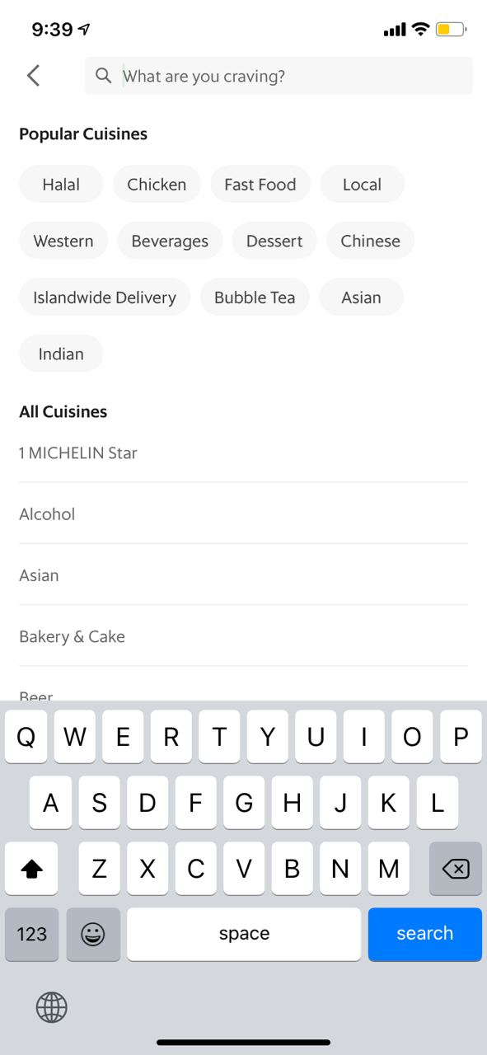
Tap on the search bar to begin searching.
Enter your search entry. Recent Searches are displayed first, and upon input the Search Results are displayed above the Recent Searches.
Press the “Back Arrow” to return to the landing page.
l
Start searching
Start searching
Start searching
Accident and Emergency
From
Current Location
Search Results
To
X-Ray Room 1
Tampines Polyclinic
2F
Tampines Polyclinic
2F
Tampines Polyclinic
2F
A&E Wing 1 Tampines Polyclinic, #03-50, S812035
A&E Wing 2 Tampines Polyclinic, #03-51, S812035
Concierge Tampines Polyclinic, #03-03, S812035
Recent Searches
Fastest
Handicap-Friendly
Least Walking
09 Sep | LT19
05 Sep | Timberland Outlet Store (Changi Airport)
31 Aug | Starbucks (Jurong Point)
31 Aug | LT2A
Consultation Room 1
Consultation Room 1
Consultation Room 1
Consultation Room 1
Recent Searches
Pantry
Pantry
Pantry
09 Sep | LT19
05 Sep | Timberland Outlet Store (Changi Airport)
Consultation Room 1
X-Ray Room 1
X-Ray Room 1
X-Ray Room 1
#02-07, 1min Walk
Current Estimated Wait Time: 50mins
Opening Hours: 10am to 5pm Daily
Consultation Room 2
Consultation Room 2
Consultation Room 2
Start
Additional Information
Walk-in allowed
Please bring identification card
Estimated Time: < 3 minutes
1. Walk Straight (5m)
2. Left Turn (2m)
3. Right Turn (1m)
Directions
Start
Call

Slide 12


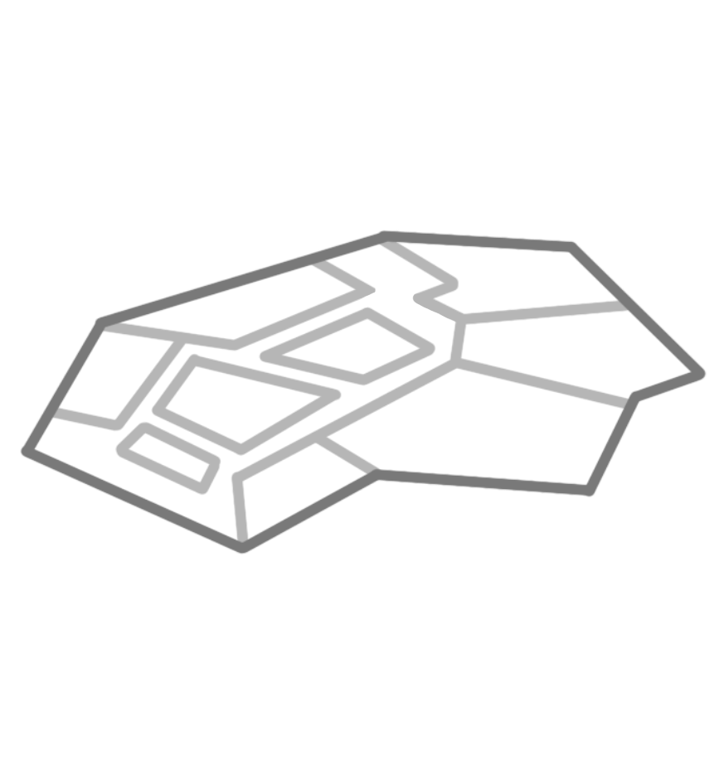
Start searching
Start searching
Tampines Polyclinic
2F
Tampines Polyclinic
2F
To enter the Multi-Level View, pinch to zoom out until a haptic feedback is received and then pinch further.
Consultation Room 1
Pantry
Pantry
Consultation Room 1
X-Ray Room 1
X-Ray Room 1
Consultation Room 2
Consultation Room 2
Notes:
Pinch to zoomout to level view

Slide 13

Scroll on the screen or using the scroll bar to traverse the multi-level view.
There is a slight haptic feedback when the user uses the scroll bar. This is feedback for the user to know when to begin scrolling.
Notice that the floor at the top is also updated from 2F to 3F.
Start searching
Tampines Polyclinic
3F
Tampines Polyclinic
2F
Pantry
Consultation Room 1
Triage
X-Ray Room 1
A&E Wing 1
A&E Wing 2
Consultation Room 2
Concierge
Notes:
Multi-Storey Swipe Scroll

Slide 14
Start searching
Start searching
Tampines Polyclinic
3F
Tampines Polyclinic
3F
Tap on the desired level to enter the map for that particular floor.
Triage
Triage
A&E Wing 1
A&E Wing 1
A&E Wing 2
Concierge
A&E Wing 2
Concierge
Notes:
Select Level

Slide 15
Start searching
Tampines Polyclinic
3F
Select a new POI on that floor.
Triage
A&E Wing 2
A&E Wing 1
#03-51, 8 min Walk
Current Estimated Wait Time: 20 mins
Opening Hours: 24 Hours
A&E Wing 2
Concierge
Additional Information
Walk-in allowed
Please bring identification card
Wear mask at all time
Pets allowed
Directions
Start
Call

Slide 16
Press “Directions” to view multi-level directions.
The floor to be reached will always be shown on top of any stack of floors (not applicable here as we are only going from Level 2 to Level 3), and all floors above the floor to be reached (like Level 4 in this example) will be omitted.
From
Current Location
Start searching
To
A&E Wing 2
Tampines Polyclinic
3F
Fastest
Handicap-Friendly
Least Walking
A&E Wing 2
Triage
Consultation Room 1
A&E Wing 2
Pantry
A&E Wing 1
X-Ray Room 1
#03-51, 8 min Walk
Current Estimated Wait Time: 20 mins
Opening Hours: 24 Hours
Consultation Room 2
A&E Wing 2
Start
Concierge
Additional Information
Walk-in allowed
Please bring identification card
Wear mask at all time
Pets allowed
Estimated Time: < 3 minutes
1. Walk Straight (5m)
2. Left Turn (2m)
3. Right Turn (1m)
Directions
Start
Call

Slide 17
From
Current Location
Start searching
To
A&E Wing 2
Select Handicap-Friendly to view the handicap friendly route.
In this case the elevator is shown and the escalator is removed to reduce irrelevant clutter.
Tampines Polyclinic
3F
Fastest
Handicap-Friendly
Least Walking
Fastest
Handicap-Friendly
A&E Wing 2
Triage
Consultation Room 1
A&E Wing 2
Pantry
A&E Wing 1
X-Ray Room 1
#03-51, 8 min Walk
Current Estimated Wait Time: 20 mins
Opening Hours: 24 Hours
Consultation Room 2
A&E Wing 2
Start
Concierge
Additional Information
Walk-in allowed
Please bring identification card
Wear mask at all time
Pets allowed
Estimated Time: < 3 minutes
1. Turn Left (5m)
2. Turn Right (10m)
3. Turn Left (1m)
4. Take elevator to 3rd Floor
…
Estimated Time: < 3 minutes
1. Walk Straight (5m)
2. Left Turn (2m)
3. Right Turn (1m)
Directions
Start
Call

Slide 18
From
Current Location
Start searching
To
A&E Wing 2
Tampines Polyclinic
3F
Fastest
Handicap-Friendly
Least Walking
Fastest
Handicap-Friendly
Pull up the drawer to view more information such as the full steps of directions (scrollable drawer) and miscellaneous information.
A&E Wing 2
Triage
Consultation Room 1
A&E Wing 2
Pantry
A&E Wing 1
X-Ray Room 1
Estimated Time: < 3 minutes
1. Turn Left (5m)
2. Turn Right (10m)
3. Turn Left (1m)
4. Take elevator to 3rd Floor
5. Turn Left (10m)
6. Turn Right (5m)
Note: Wheelchair ramp at A&E Wing 2 Entrance.
#03-51, 8 min Walk
Current Estimated Wait Time: 20 mins
Opening Hours: 24 Hours
Consultation Room 2
A&E Wing 2
Concierge
Additional Information
Walk-in allowed
Please bring identification card
Wear mask at all time
Pets allowed
Estimated Time: < 3 minutes
1. Turn Left (5m)
2. Turn Right (10m)
3. Turn Left (1m)
4. Take elevator to 3rd Floor
…
Directions
Start
Call

Slide 19
From
Current Location
Start searching
To
A&E Wing 2
Tampines Polyclinic
3F
Fastest
Handicap-Friendly
Least Walking
Fastest
Handicap-Friendly
Pull down the drawer to view less information.
A&E Wing 2
Triage
Consultation Room 1
A&E Wing 2
Pantry
A&E Wing 1
X-Ray Room 1
Estimated Time: < 3 minutes
1. Turn Left (5m)
2. Turn Right (10m)
3. Turn Left (1m)
4. Take elevator to 3rd Floor
5. Turn Left (10m)
6. Turn Right (5m)
Note: Wheelchair ramp at A&E Wing 2 Entrance.
#03-51, 8 min Walk
Current Estimated Wait Time: 20 mins
Opening Hours: 24 Hours
Consultation Room 2
A&E Wing 2
Concierge
Additional Information
Walk-in allowed
Please bring identification card
Wear mask at all time
Pets allowed
Estimated Time: < 3 minutes
1. Turn Left (5m)
2. Turn Right (10m)
3. Turn Left (1m)
4. Take elevator to 3rd Floor
…
Directions
Start
Call

Slide 20
References for Assets
Assets | References | Assets | References
 | Icons made by <a href="https://www.flaticon.com/free-icon/loupe_875623" title="Kiranshastry">Kiranshastry</a> from <a href="https://www.flaticon.com/" title="Flaticon"> www.flaticon.com</a> |  | Icons made by <a href="https://www.flaticon.com/authors/freepik" title="Freepik">Freepik</a> from <a href="https://www.flaticon.com/" title="Flaticon"> www.flaticon.com</a>
 | Icons made by <a href="https://www.flaticon.com/authors/monkik" title="monkik">monkik</a> from <a href="https://www.flaticon.com/" title="Flaticon"> www.flaticon.com</a> |  | Icons made by <a href="https://www.flaticon.com/authors/freepik" title="Freepik">Freepik</a> from <a href="https://www.flaticon.com/" title="Flaticon"> www.flaticon.com</a>
 | Icons made by <a href="https://www.flaticon.com/authors/kiranshastry" title="Kiranshastry">Kiranshastry</a> from <a href="https://www.flaticon.com/" title="Flaticon"> www.flaticon.com</a> |  | Icons made by <a href="https://www.flaticon.com/authors/pixelmeetup" title="Pixelmeetup">Pixelmeetup</a> from <a href="https://www.flaticon.com/" title="Flaticon">www.flaticon.com</a></div>
 | Icons made by <a href="https://www.flaticon.com/authors/freepik" title="Freepik">Freepik</a> from <a href="https://www.flaticon.com/" title="Flaticon"> www.flaticon.com</a> |  | Icons made by <a href="https://www.flaticon.com/authors/freepik" title="Freepik">Freepik</a> from <a href="https://www.flaticon.com/" title="Flaticon"> www.flaticon.com</a>
 | Icons made by <a href="https://www.flaticon.com/authors/freepik" title="Freepik">Freepik</a> from <a href="https://www.flaticon.com/" title="Flaticon"> www.flaticon.com</a> |  | Icons made by <a href="https://www.flaticon.com/authors/google" title="Google">Google</a> from <a href="https://www.flaticon.com/" title="Flaticon"> www.flaticon.com</a>
 | Icons made by <a href="https://www.flaticon.com/authors/freepik" title="Freepik">Freepik</a> from <a href="https://www.flaticon.com/" title="Flaticon"> www.flaticon.com</a> |  | Icons made by <a href="https://www.flaticon.com/authors/freepik" title="Freepik">Freepik</a> from <a href="https://www.flaticon.com/" title="Flaticon"> www.flaticon.com</a>
 | Icons made by <a href="https://www.flaticon.com/authors/pixel-perfect" title="Pixel perfect">Pixel perfect</a> from <a href="https://www.flaticon.com/" title="Flaticon"> www.flaticon.com</a>

